Slide 1

ML IN HEALTH CARE - PREDICTING HEALTH INSURANCE PRICES
Group Number - 07
Manpreet Singh Sandhu
Vishwajeeth Balaji
Nagendra Madi Reddy
EET 4501
Applied Machine Learning

Slide 2
INTRODUCTION
Insurance pricing is a critical aspect of risk management, highlighting the need for proactive approaches and predictive techniques to ensure fair and accurate pricing for policyholders.
This study aims to forecast insurance prices using advanced AI models, evaluating their performance to determine the most effective model for pricing accuracy and reliability.
The dataset utilized for this research comprises approximately 1,500+ policyholder records sourced from reliable sources. It includes essential attributes such as age, gender, geographical location, coverage history, claim frequency, and policy type.

Slide 3
DATASET OVERVIEW
We have selected our dataset from Kaggle.
The data have 6 independent attributes that contribute to the insurance price such as the age, sex, BMI, smoking status, region and children.
The data consist of target feature known as the charges.
The Dataset is original patient dataset which consists of nearly 1300+ records.

Slide 4
TYPE OF APPROACH
Data collected from the Kaggle repository “US health Insuarne Premium Charges Dataset”.
Performing the Exploratory Data Analysis using Pandas,Numpy, Matplotlib and Seaborn libraries.
Finding the Skewness of the dataset.
Creating Correlation matrix to come up with a conclusion which attributes have a possible linear relationship with the output.

Slide 5
TYPE OF APPROACH
Selecting the important features from the dataset using XGB Regressor Model.
Based on the feature importance method we found that 3 attributes are having the high coefficient values (Smoker, BMI & Age)
Splitting the dataset into 3 parts training set, validation set and test set.
Using the Import features finding the accuracy for every ML model such as KNN, SVR, RF, LR, GB Regressor, and XGB Regressor.
Selecting the model with the best test set accuracy, F1 score, Precision and Recall value.
Deploying the model to make future predictions.

Slide 6
EXPLORATORY DATA ANALYSIS
We are performing EDA on every attribute which is a categorical data to know the distribution of data and know if it is balanced or not.
Using map function we convert categorical data labels to 0’s, 1’s and so on.
Now we are performing correlation on the dataset to know what all attributes are highly correlated and which are not.
Performing the histogram plot on the dataframe to summarize discrete or continuous data that are measured on a particular interval.

Slide 7
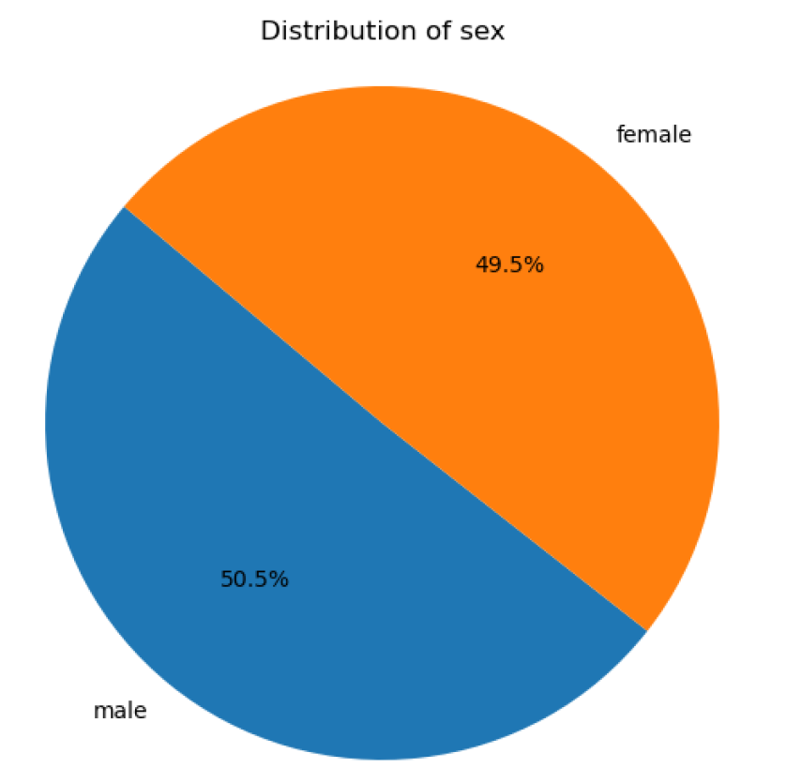
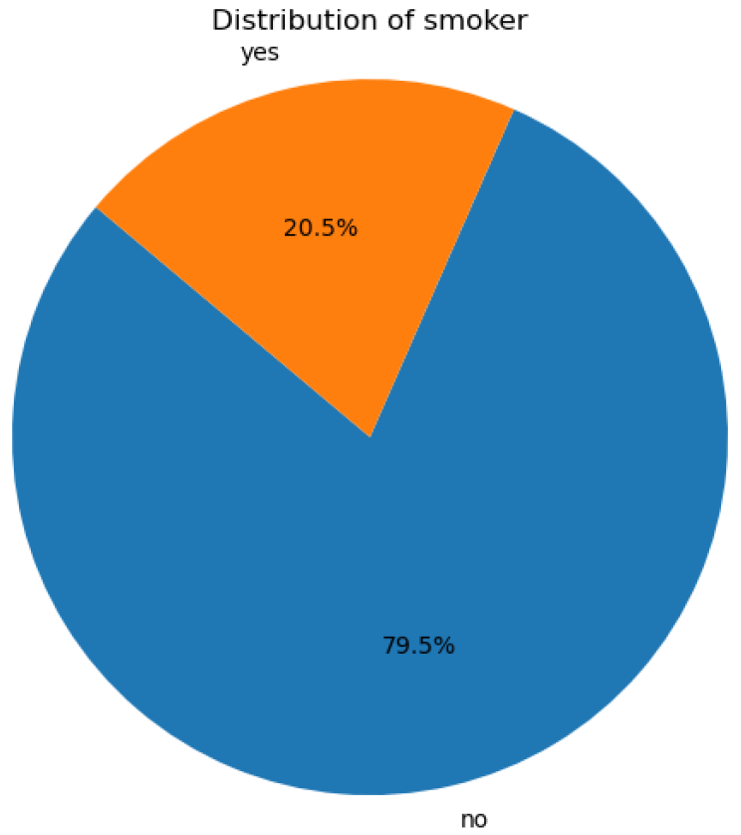
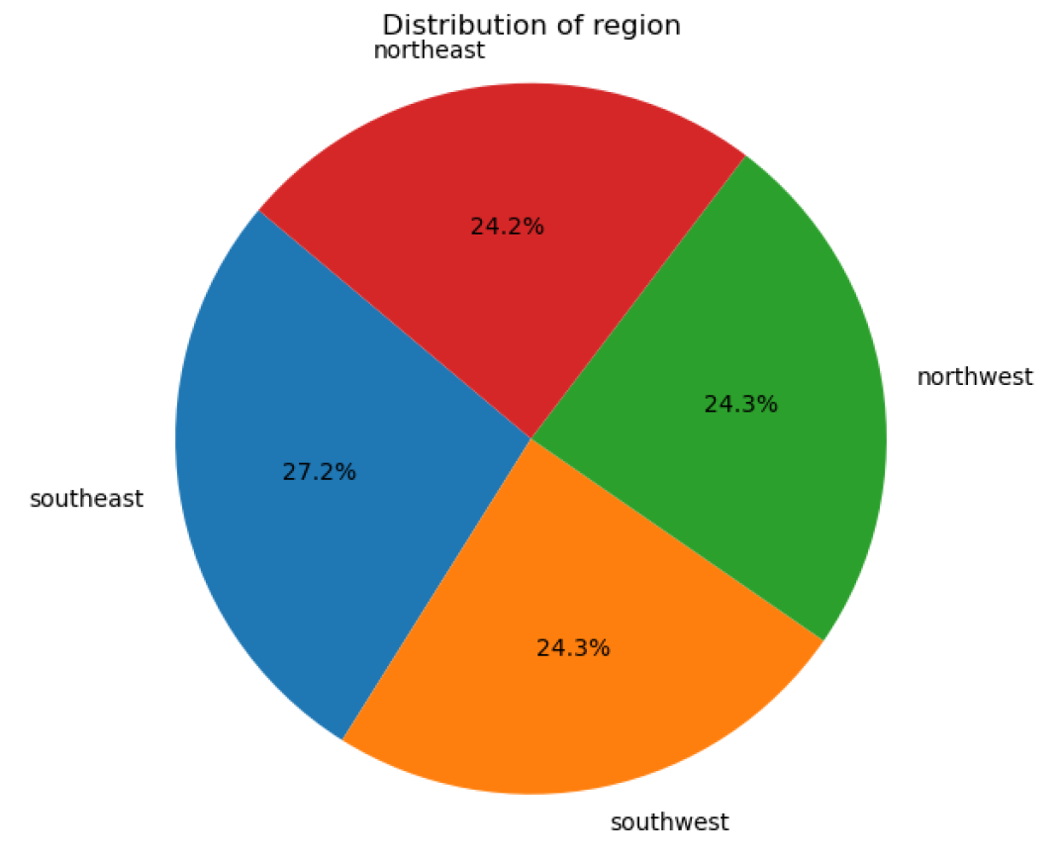
VISUAL REPRESENTATION OF EDA

Slide 8
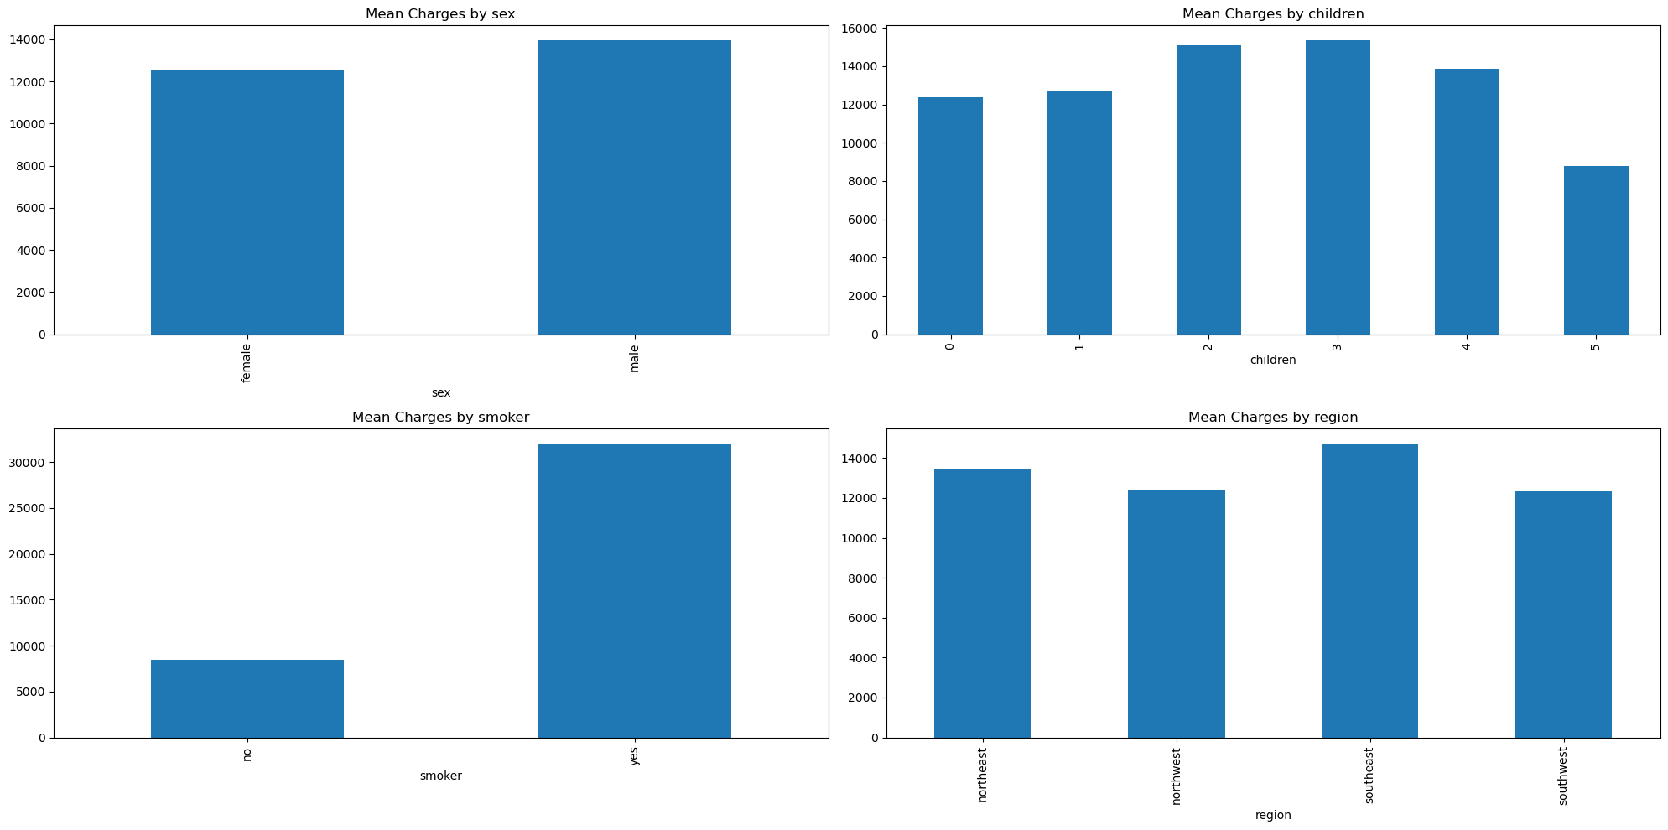
EDA

Slide 9
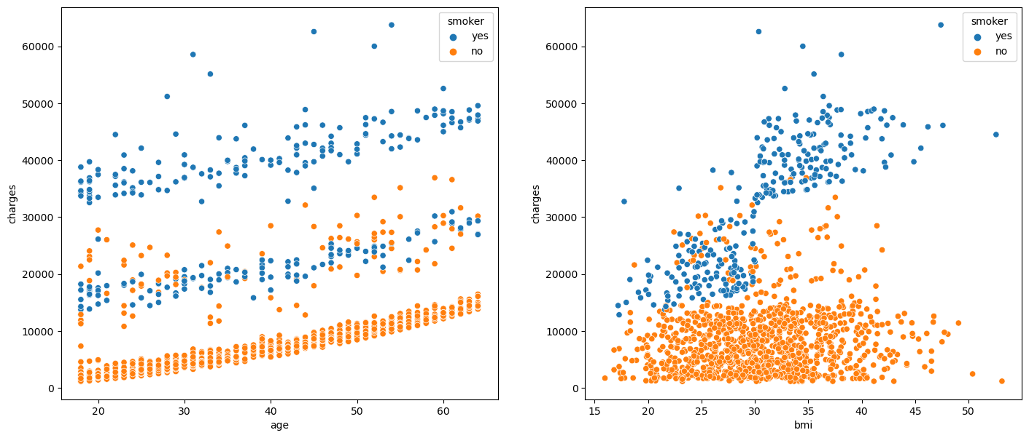
EDA

Slide 10
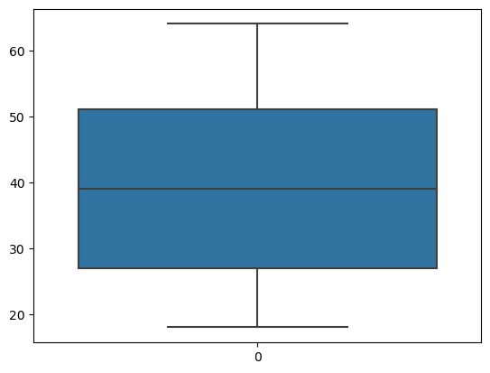

Slide 11
MODEL ARCHITECTURE
Dataset Collection
Normalization and Preprocessing
Feature Subset Selection using Relevant Attributes
Best model prediction based on performance
Result Analysis
Classification Algorithm

Slide 12
MODEL ANALYSIS
Data Splitting: The dataset is split into features (X) and the target variable (Y). It's assumed that the features are stored in a DataFrame named df, and the target variable is named 'charges'. The data is split into training and testing sets using the train_test_split function.
Linear Regression Model Evaluation: The code initializes a Linear Regression model (lrmodel) and fits it to the training data. It calculates and stores the training and testing accuracy scores (l1 and l2 respectively) and the mean cross-validation score (l3) using a loop with different random_state values. The results are stored in a DataFrame named df1.
Support Vector Regression (SVR) Model Evaluation: An SVR model is initialized and fitted to the training data. Predictions are made on the training and testing data, and R-squared scores are calculated. Mean cross-validation score is calculated.
Random Forest Model Evaluation: A Random Forest Regressor model is initialized and fitted to the training data. Predictions are made on the training and testing data, and R-squared scores are calculated. Mean cross-validation score is calculated. Grid search is performed to find the best parameters for the Random Forest model, and the model is re-initialized and refitted with the best parameters.

Slide 13
MODEL ANALYSIS
Gradient Boosting Model Evaluation: A Gradient Boosting Regressor model is initialized and fitted to the training data. Predictions are made on the training and testing data, and R-squared scores are calculated. Mean cross-validation score is calculated. Grid search is performed to find the best parameters for the Gradient Boosting model, and the model is re-initialized and refitted with the best parameters.
XGBoost Model Evaluation: An XGBoost Regressor model is initialized and fitted to the training data. Predictions are made on the training and testing data, and R-squared scores are calculated. Mean cross-validation score is calculated. Grid search is performed to find the best parameters for the XGBoost model, and the model is re-initialized and refitted with the best parameters.
Model Comparison: Finally, a DataFrame named model_comparison is created to store the performance metrics (training score, testing score, cross-validation score) of all the models.

Slide 14
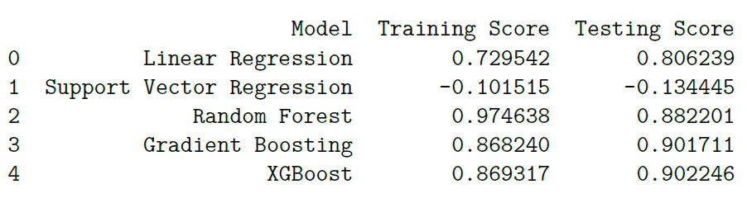
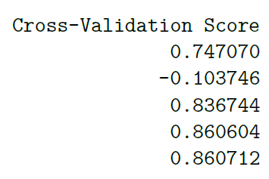
MODEL PERFORMANCE CLASSIFICATION REPORT

Slide 15
FEATURE ANALYSIS & MODEL EVALUATION
Feature Importance Analysis: The importance of features is analyzed using the best estimator obtained from the grid search in the XGBoost model. The feature importances are stored in a DataFrame named feats. Only features with importance greater than 0.01 are considered significant and stored in a DataFrame named important_features.
Model Evaluation and Comparison: A final XGBoost model is defined with specified hyperparameters (n_estimators=15, max_depth=3, gamma=0). The 'sex' and 'region' columns are dropped from the DataFrame as they were determined to be less important. Data is split into training and testing sets. Various regression models, including the final XGBoost model, are evaluated on the dataset. For each model, training and testing scores (R-squared) and cross-validation scores are calculated. These scores are stored in a DataFrame named scores_df for comparison. Finally, the final XGBoost model is fitted on the training data, and its performance metrics are printed, including training score, testing score, and cross-validation score.

Slide 16
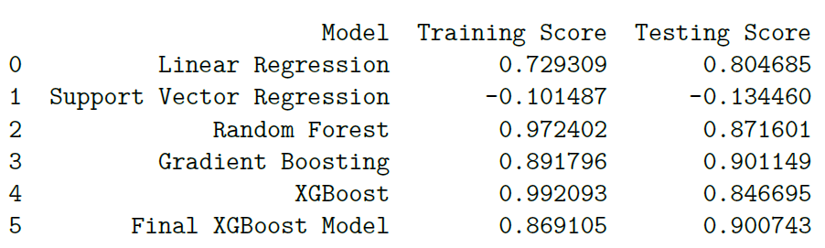
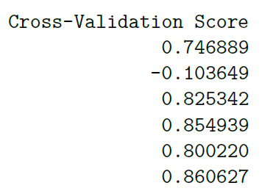
CLASSIFICATION REPORT USING FEATURE IMPORTANCE

Slide 17
MODEL PERFORMANCE HEATMAP - R-SQUARED SCORES

Slide 18
CONCLUSION
Feature importance analysis using XGBoost reveals significant features for predicting medical charges, with some features deemed more important than others. Notably, features with importance greater than 0.01 are retained for further analysis.
The regression models are assessed based on training score, testing score, and cross-validation score (R-squared). This comprehensive evaluation allows for a thorough comparison of model performance across different datasets.
Based on the evaluation results and heatmap visualization, it can be concluded that the final tuned XGBoost model performs competitively well compared to other models in predicting health insurance prices, exhibiting high predictive accuracy across all evaluation metrics.
The final tuned XGBoost model can be deployed for predicting medical charges. Additionally, further analyses such as fine-tuning hyperparameters, exploring additional features, or assessing model robustness may be conducted to improve model performance further.

Slide 19
REFERENCES
Singh, R., Ayyar, M. P., Pavan, T. S., Gosain, S., & Shah, R. R. (2019, September)- Automating Vehicle Car Insurance Claims Using Deep Learning Techniques.
In 2019 IEEE Fifth International Conference on Multimedia Big Data (BigMM) (pp. 199-207). IEEE. [4] Stucki, O. (2019) - Predicting the customer churn with machine learning methods: case: private insurance customer data.
Fauzan, M. A., & Murfi, H. (2018). The accuracy of XGBoost for insurance claim prediction. Int. J. Adv. Soft Comput. Appl, 10(2).
Kowshalya, G., & Nandhini, M. (2018, April). Predicting fraudulent claims in automobile insurance. In 2018 Second International Conference on Inventive Communication and Computational Technologies (ICICCT) (pp. 1338-1343). IEEE.

Slide 20
THANK YOU

